Slide 1
IoT
Internet of Things

Slide 2
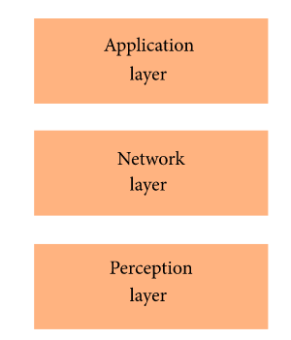
3-Layer
Application Layer
Network Layer
Perception Layer

Slide 3
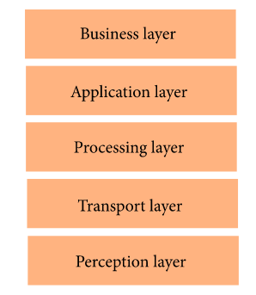
5-Layer
Business Layer
Application Layer
Processing Layer
Transport Layer
Perception Layer

Slide 4
Open IoT
https://github.com/OpenIotOrg/openiot/
Application
Request definition
Request presentation
Configuration
Virtualized
Schedular
Cloud Data storage
Service Delivary
Physical

Slide 5
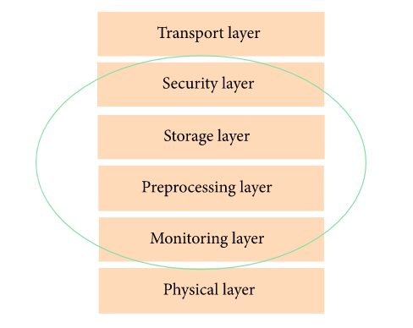
Fog
Security Layer
Storage Layer
Preprocessing Layer
Monitoring Layer

Slide 6
Framework
Device developer:
Service provider
Platform operator
Software developer
Network operator
Service users
Device Platform
Planet Platform
Mashup Platform
Store Platform

Slide 7
Desafios e Obstáculos
Gestão de Objetos
Padronização
Privacidade
Segurança dos objetos
Criptografia de dados
Segurança de Rede

